Slide 1
Jhpiego Safe Surgery: The challenge of proper post-operative care and monitoring in low-resource settings
John E. Varallo, MD, MPH, FACOG
Global Director Safe Surgery - Jhpiego
Med Hack 2019

Slide 2
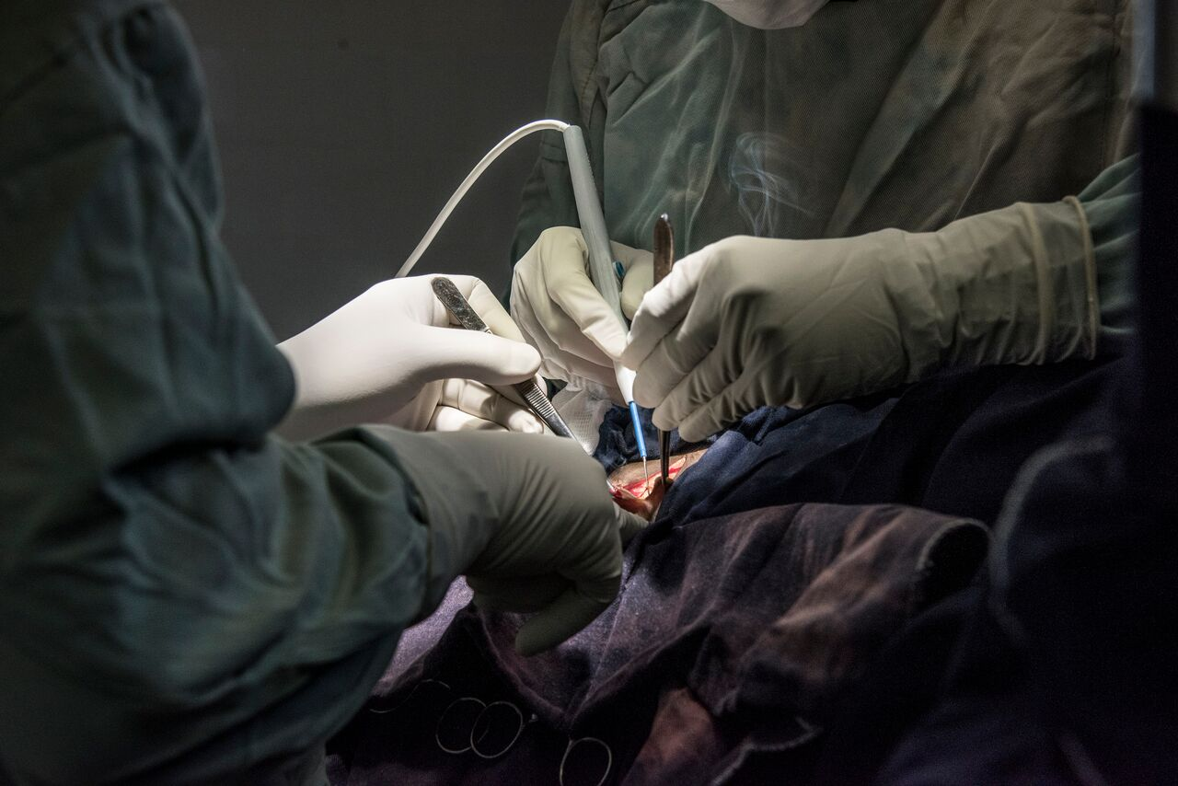
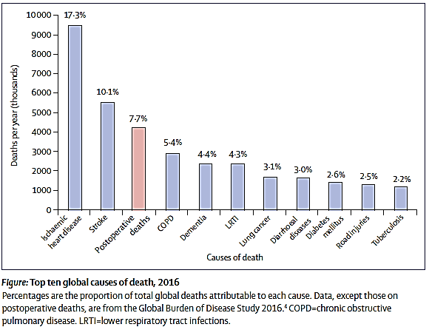
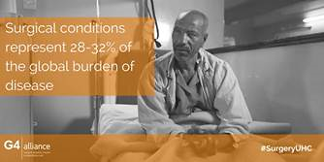
Why post-operative care?
2

Slide 3
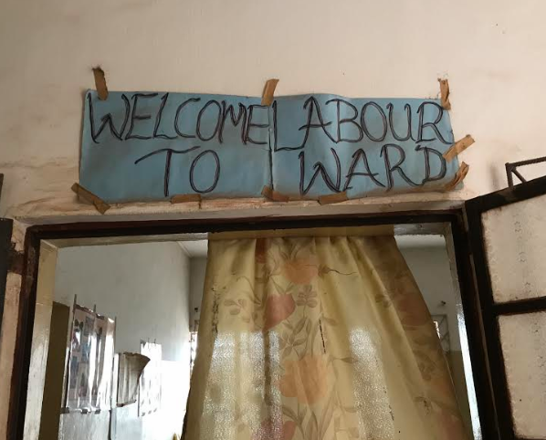
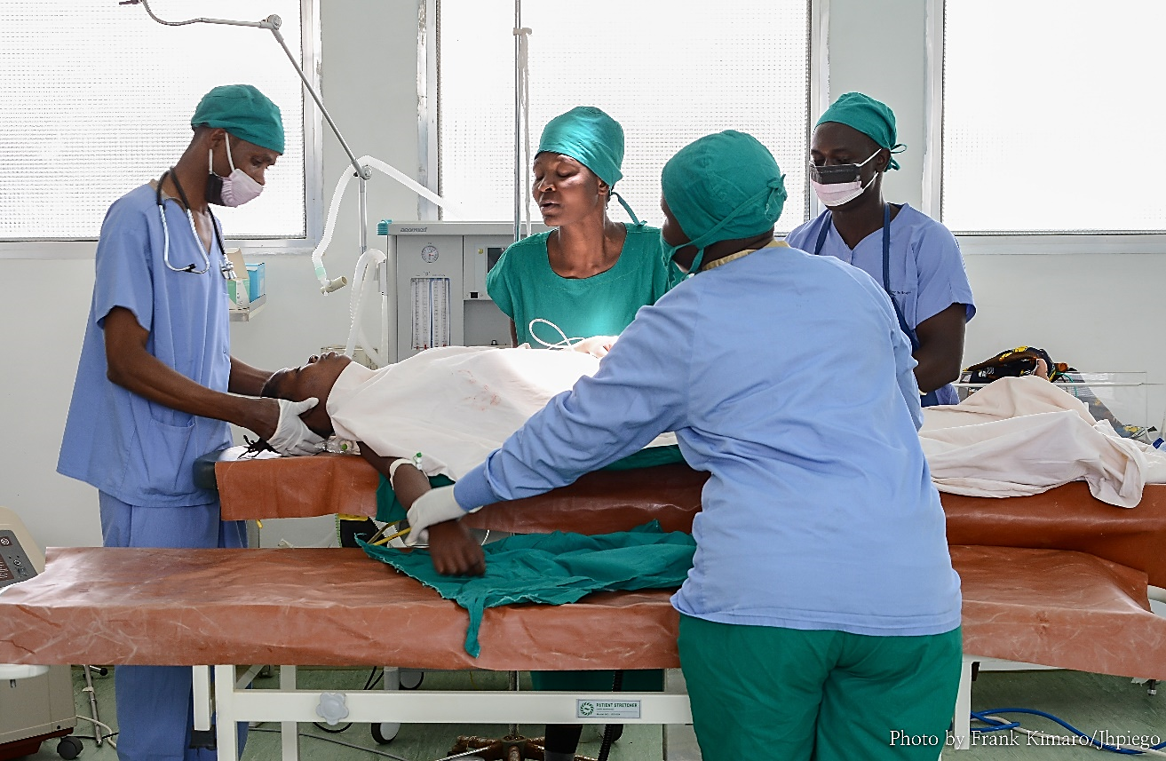
Gap in Quality Post-operative Care and Monitoring
Patients in low-income and middle-income countries (LMICs) are at a much higher risk of dying following surgery than their counterparts in richer countries¹
African mothers are 50x more likely to die after cesarean delivery than those in high-income countries²
Reasons: not detecting deteriorating conditions or acting in timely manner
¹Biccard BM, Madiba TE, et al. Perioperative patient outcomes in the African Surgical Outcomes Study: a 7-day prospective observational cohort. Lancet 2018; 391(10130):1589-1598
²Bishop D, Dyer RA, Maswime S, et al. Maternal and neonatal outcomes after cesarean delivery in the African Surgical Outcomes Study: a 7-day prospective observational cohort study. The Lancet. 2019; 7: 513-522. doi: 10.1016/S2214-109X(19)30036-1

Slide 4
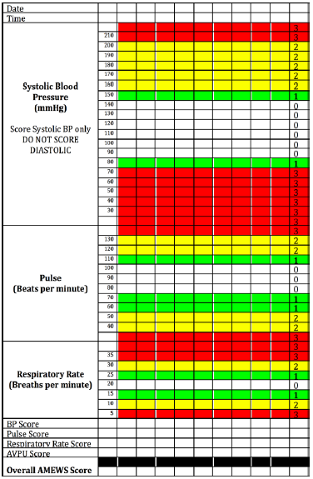
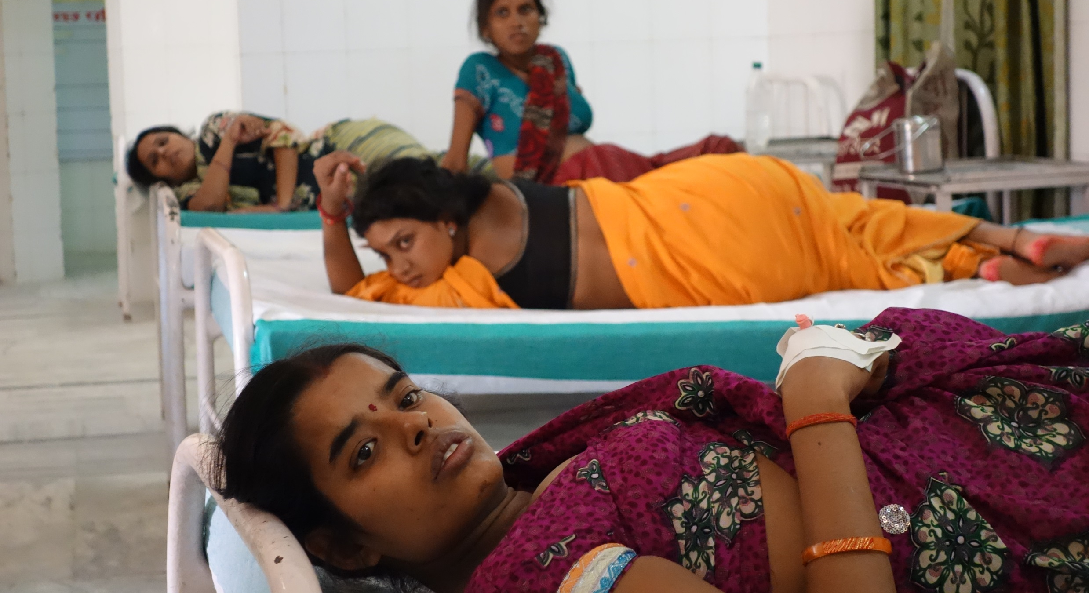
Post-operative Care and Monitoring Challenges
Human resources
Equipment and supplies
Monitoring/taking and recording of vital signs
Decision support
Early warning scoring systems
Risk stratification/treatment algorithms

Slide 5
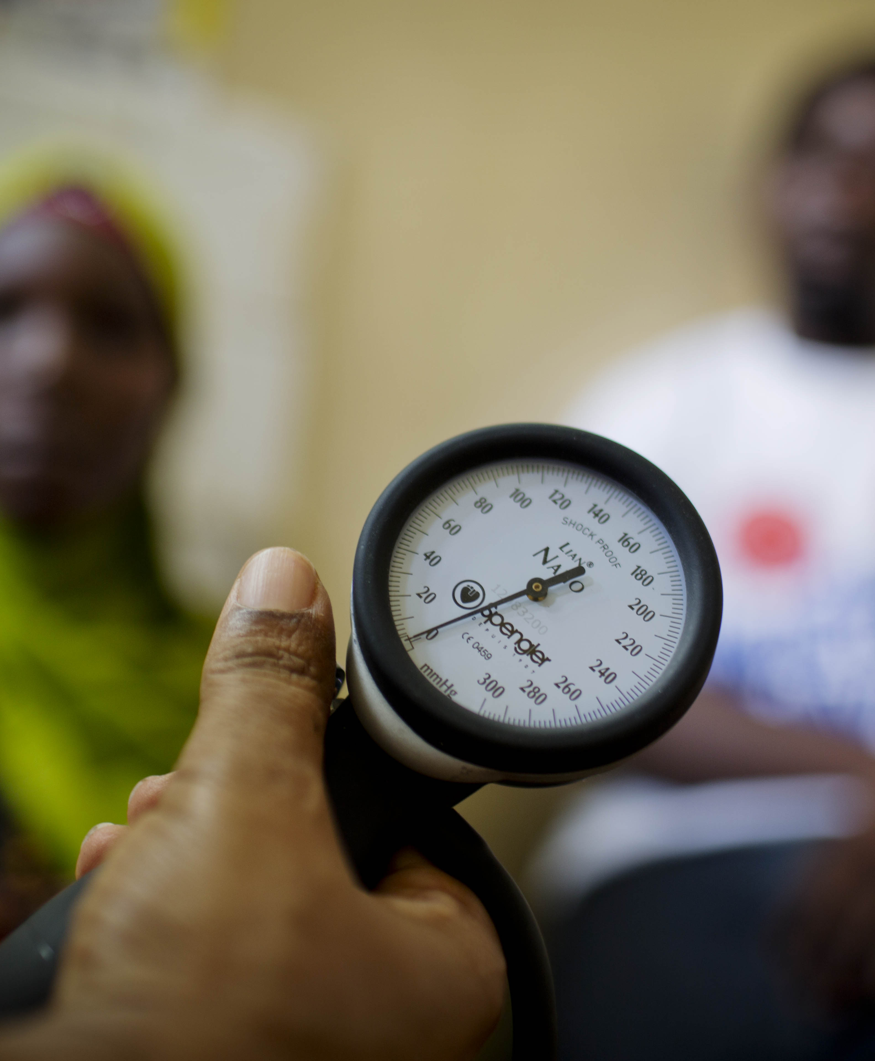
Post-operative Care: potential for wearable technologies
Purpose:
Overcome human resource challenges
Overcome lack of basic equipment and supplies
Improve operational efficiencies and quality
Provide clinical decision support

Slide 6
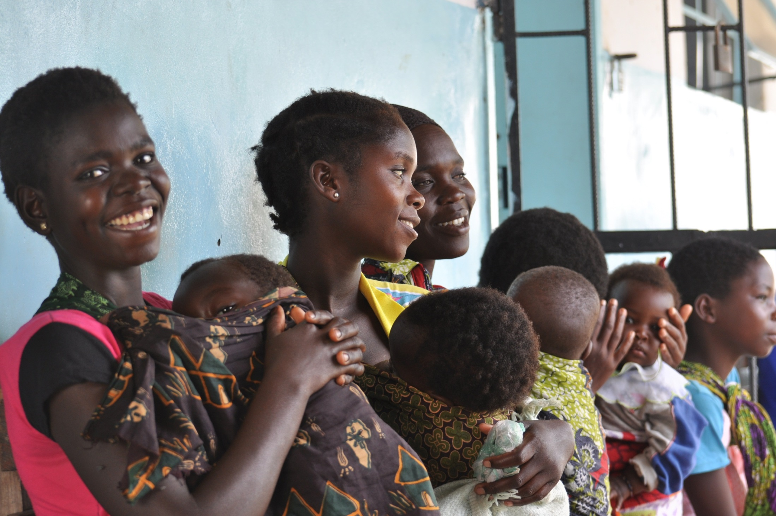
Thank You!

